Slide 1
Momentum Prediction Strategy
Ryan Challman

Slide 2
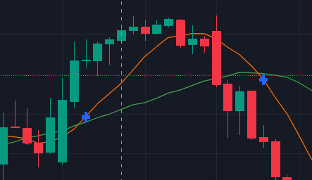
Thesis
Momentum, in specific MA, strategies tend to lag before they purchase equities
Primarily, because they have to wait for the market price to increase for momentum to begin
Solution: Use the second derivative of moving averages to create a buy or sell signal
Additionally, filter by volatility where low levels of recent volatility allows us to go long, vice versa for short

Slide 3
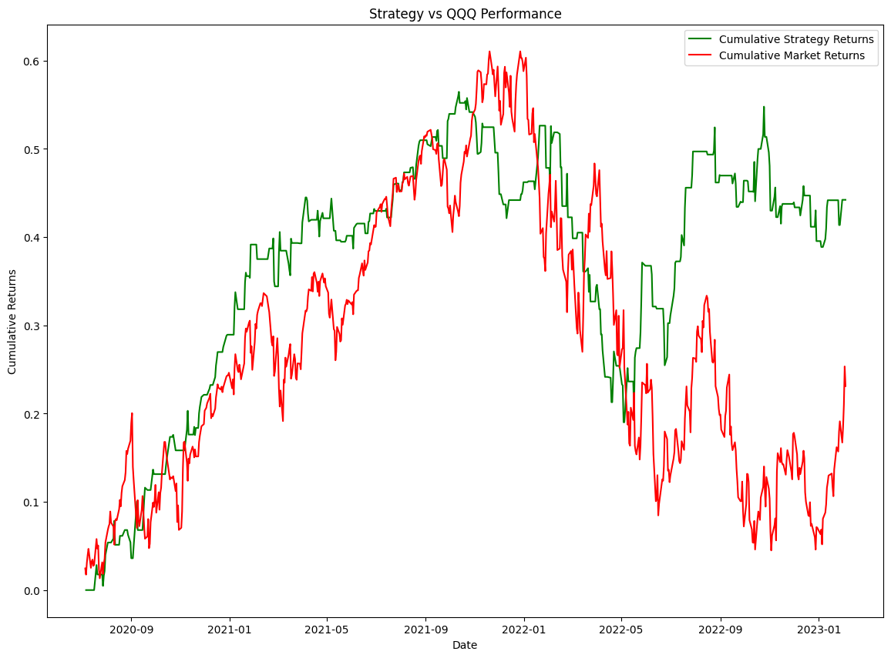
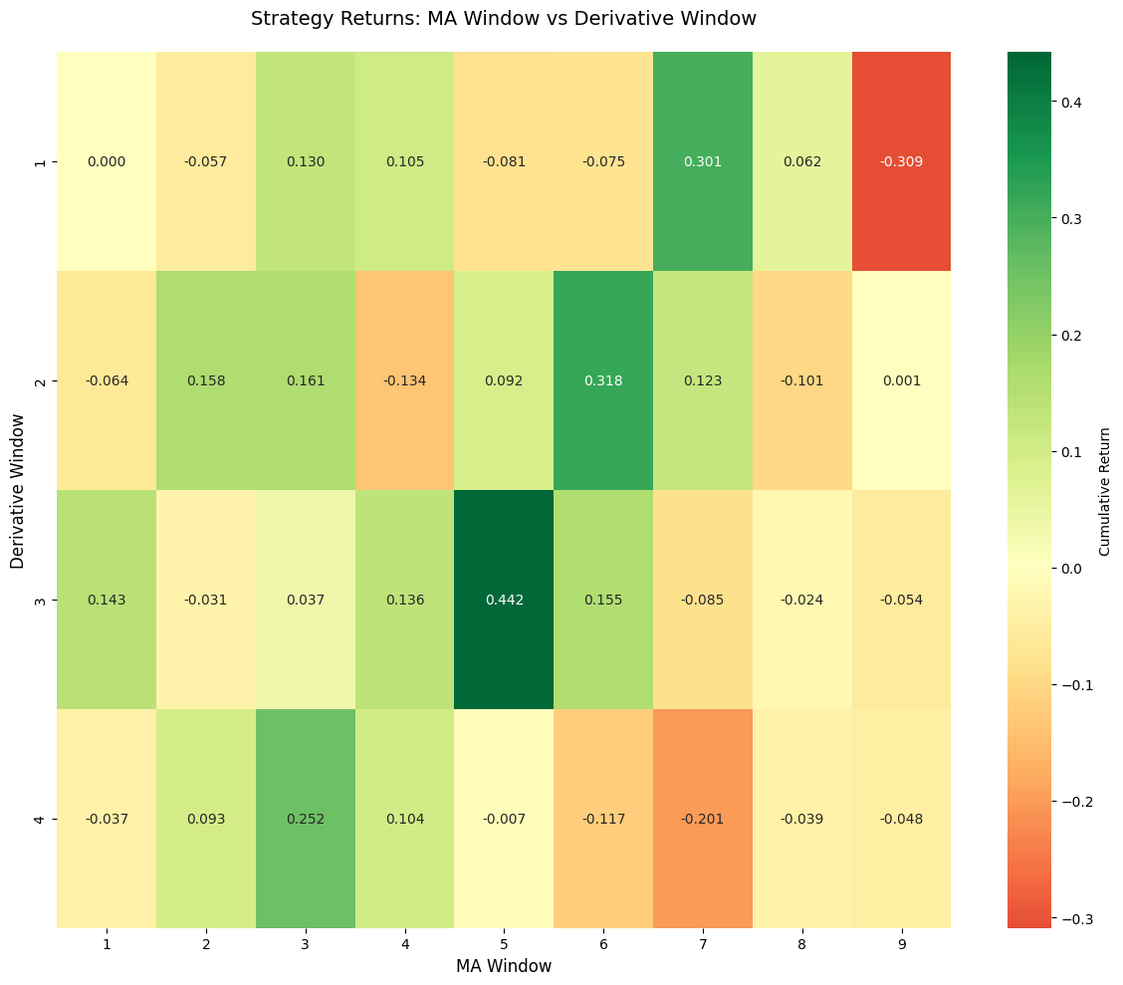
Choosing Parameter/In-Sample Testing
Create a heatmap and adjust 2 parameter MA_Window and derivative_window
Have our target be cumulative returns
Baseline will be QQQ from 2020-2023

Slide 4
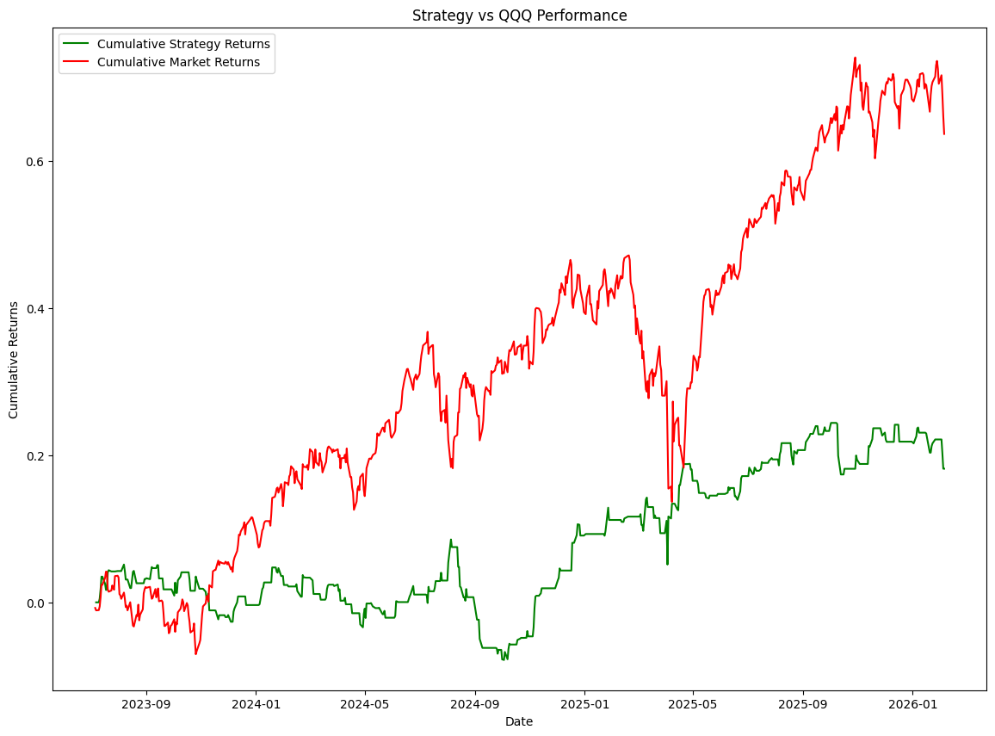
Out of Sample Performance
Maintain the same parameters from out of sample testinging
Test performance of strategy from 2022 to 2026
Strategy/QQQ
18.16% returns/63.67% returns
.28 Sharpe Ratio/.88 Sharpe
.29 Sortino Ratio/1.17 Sortino

Slide 5
Conclusion
While there was some reasoning behind why the idea should work any market is far too complex to have any real edge while using strictly technical indicators. For the future it could be useful to narrow in on individual companies and look at how the sentiment of either the individual company is looking or their industry as a whole. While for the model adding in transaction cost and looking at shorter time frames where prices aren’t as driven by actual business fundamentals could have better results.
Questions?

